Slide 1
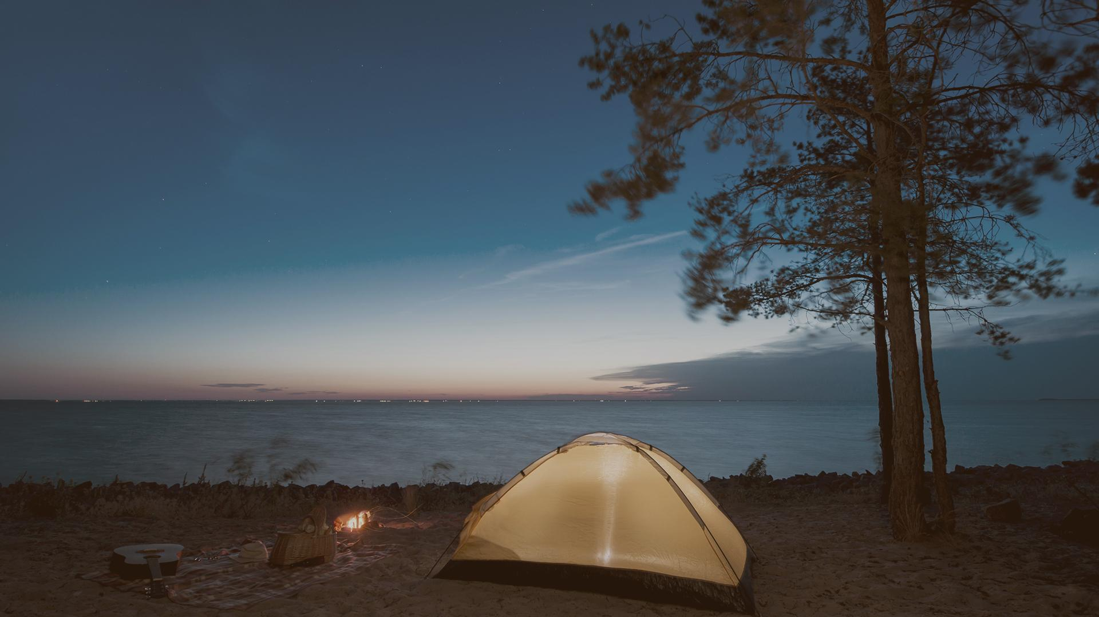
WONDER PLACE
PROGRAMMING WARRIOR’S PRESENTATION
This is a website that can support you when you want to travel!

Slide 2
01
02
TABLE OF CONTENTS
03
04
OVERVIEW
Give an overview of the site
USES
Uses of the website
SYSTEM DESIGN
Website creation tools
RESULT
Goal achieved, several interfaces

Slide 3

01
OVERVIEW
Give an overview of the website!

Slide 4

REASONS TO CREATE WONDER PLACE!
FIRST REASON
THIRD REASON
Tourism attracts the attention of many people
Travel is always the first choice of people on vacation.
SECOND REASON
FOURTH REASON
Traveling always brings great value
People still have many problems related to travel
Notes:
Nowadays, traveling always brings great value, is a way to preserve memories with friends and relatives. Tourism is also a form of providing knowledge, expanding understanding of the world around, moreover a way to exercise. For those reasons, travel is always the first choice of people on vacation.
People still have many problems related to travel, from location, means of transportation, time, accommodation or activities during the trip.
For those reasons, WONDER PLACE is a website to help people overcome these problems.

Slide 5
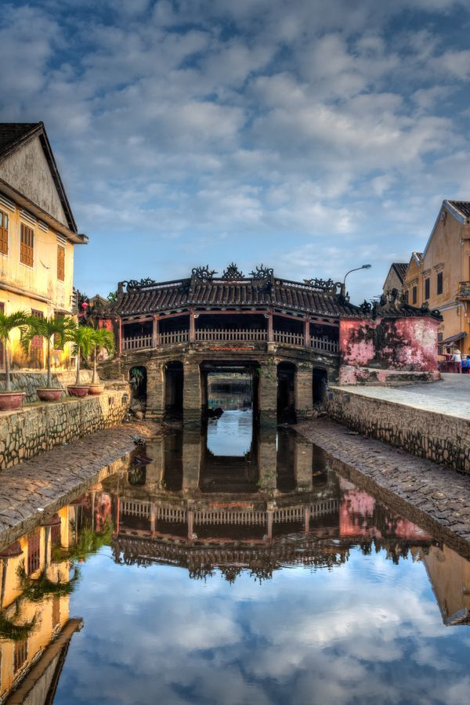
02
USES
Uses of the website.

Slide 6

WONDER PLACE can help you:
FIRST THING
SECOND THING
Choose the right travel destination
Book flight tickets, hotel rooms
THIRD THING
FOURTH THING
Book photographer
Choose the right tour
Notes:
WONDER PLACE is a website that can support you when you want to travel! So when you have any trouble with your trip, go to WONDER PLACE, it can help you:
- Choose the right travel destination
- Book flight tickets, hotel rooms.
- Book photographer
- Book tour

Slide 7
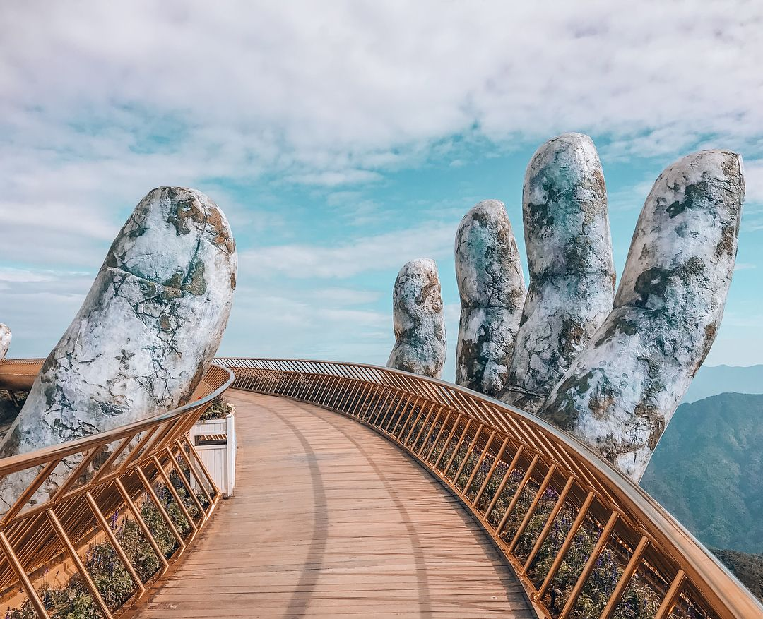
03
SYSTEM DESIGN
Website creation tools.

Slide 8
WONDER PLACE is built using the following tools
HTML, CSS
JAVASCRIPT
MongoDB
NodeJS
Build interface for web
Handle user requests
Create database for website
Tesing
Notes:
WONDER PLACE is a website built on HTML and CSS programming languages, combine Bootstrap, JavaScript, in addition, there is a MongoDB database and a test run on NodeJS
-Like many other websites, WONDER PLACE's interface is built on HTML and CSS
-JavaScript is used to handle user requests
-The website's database is built on MongoDB
-Finally, the site uses NodeJS for testing

Slide 9
04
RESULT
Overview of the website interface.
.

Slide 10
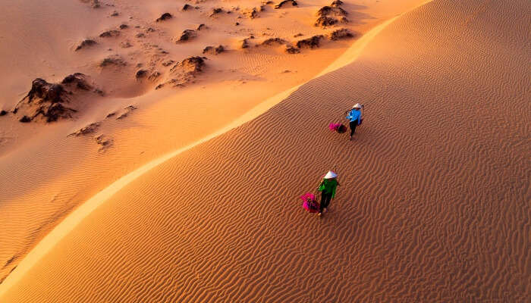
Our goal is to create a website with all the following conditions:
BEAUTIFUL INTERFACE
EASY TO USE
FULL FUNCTIONAL
Interface is the first thing that attracts users when they visit any website
User-friendly, not too cumbersome, confusing, causing difficulty for visitors
Besides the interface, the function of the website must meet the requirements of the visitors
Notes:
Our goal is to create a website with all the following conditions:
-Beautiful interface: Interface is the first thing that attracts users when they visit any website
-Easy to use: user-friendly, not too cumbersome, confusing, causing difficulty for visitors.
-Besides the interface, the function of the website must meet the requirements of the visitors

Slide 11
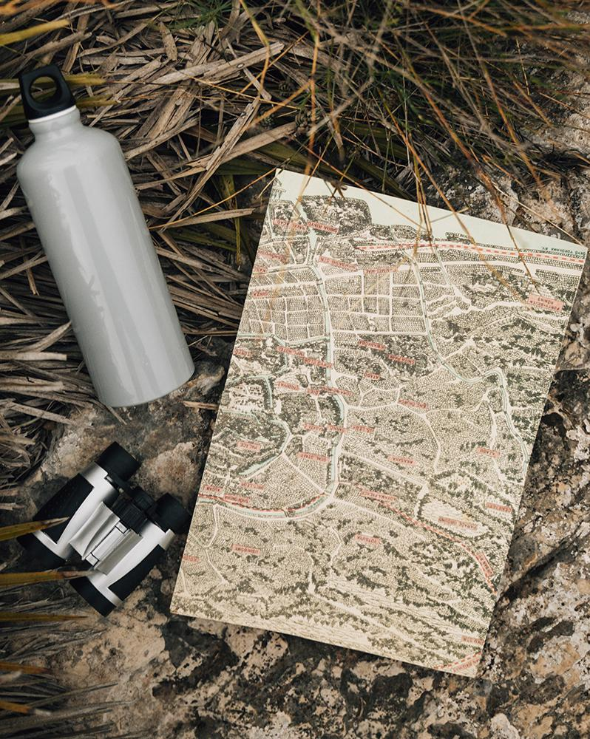
SOME FUNCTION HAVE BEEN COMPLETED...
Would like to introduce some of the functions that we have completed.

Slide 12
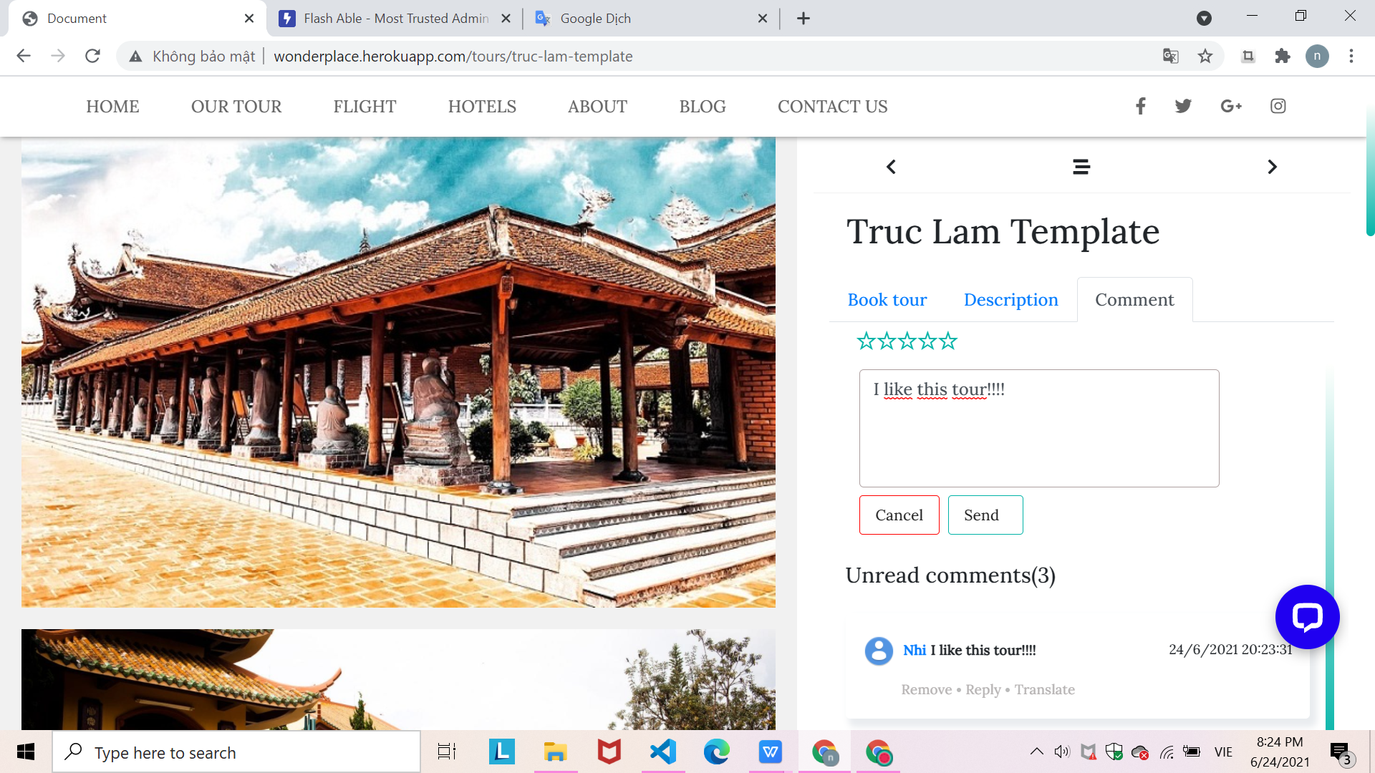
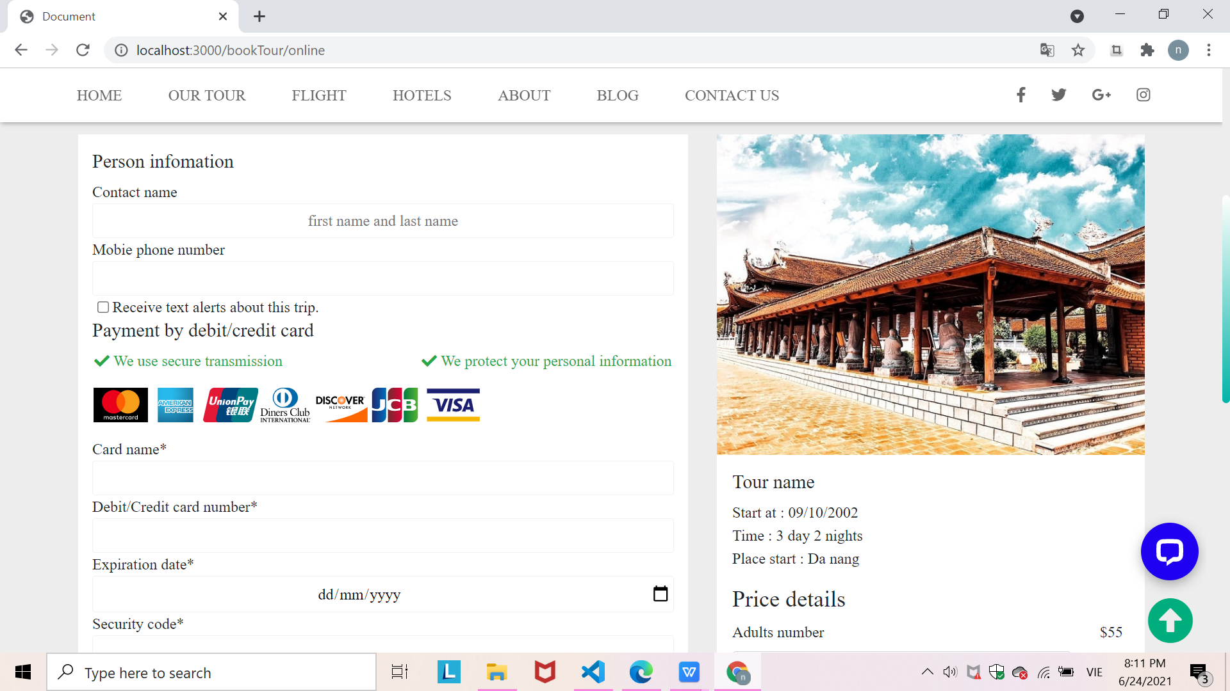
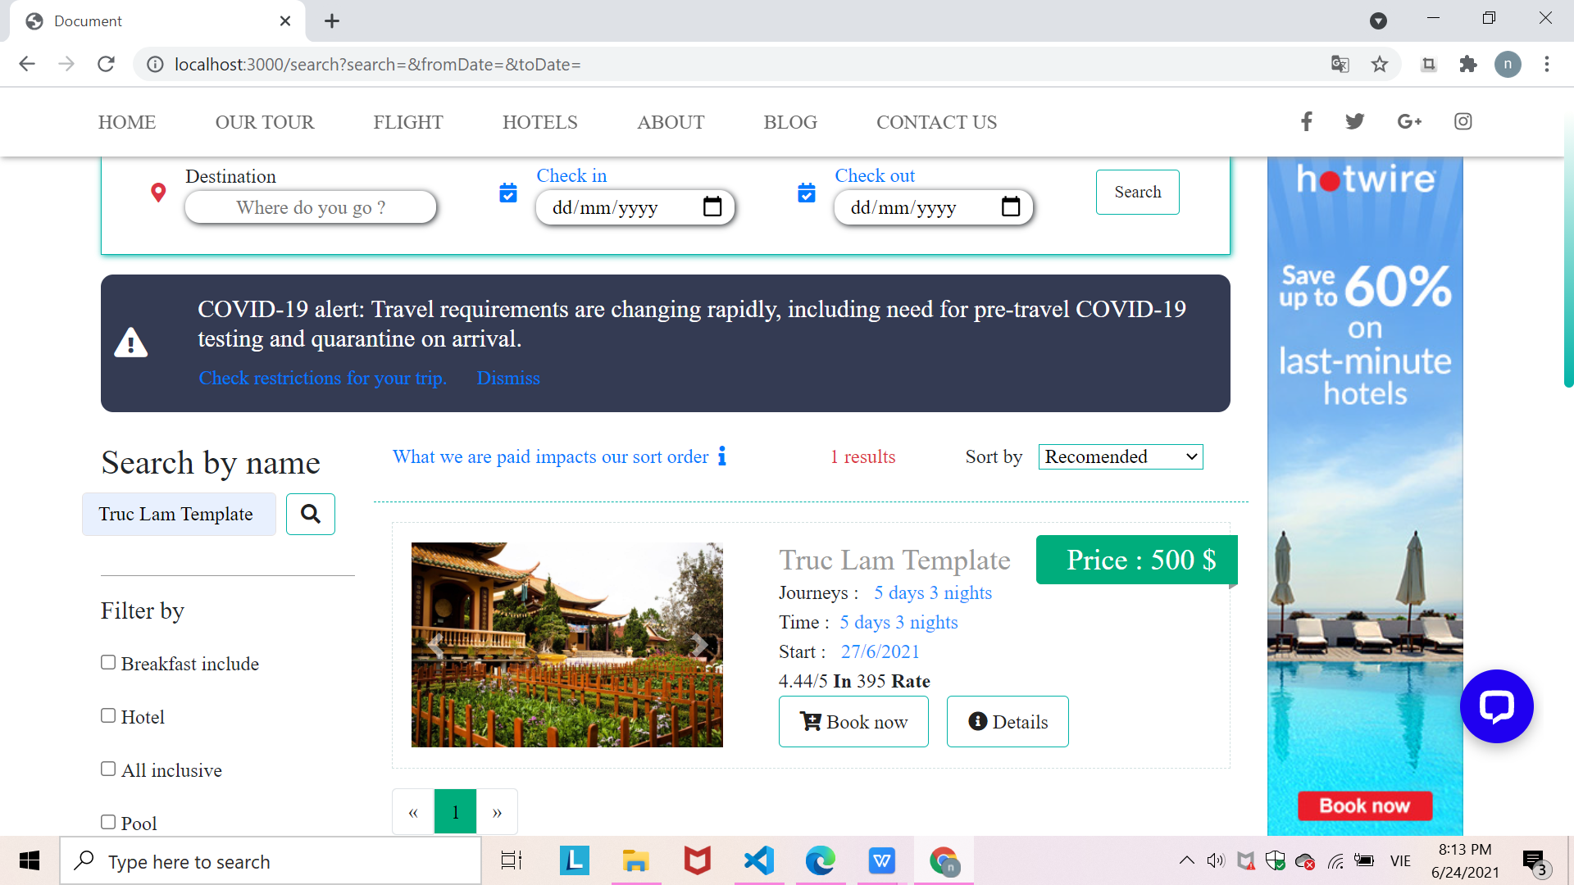
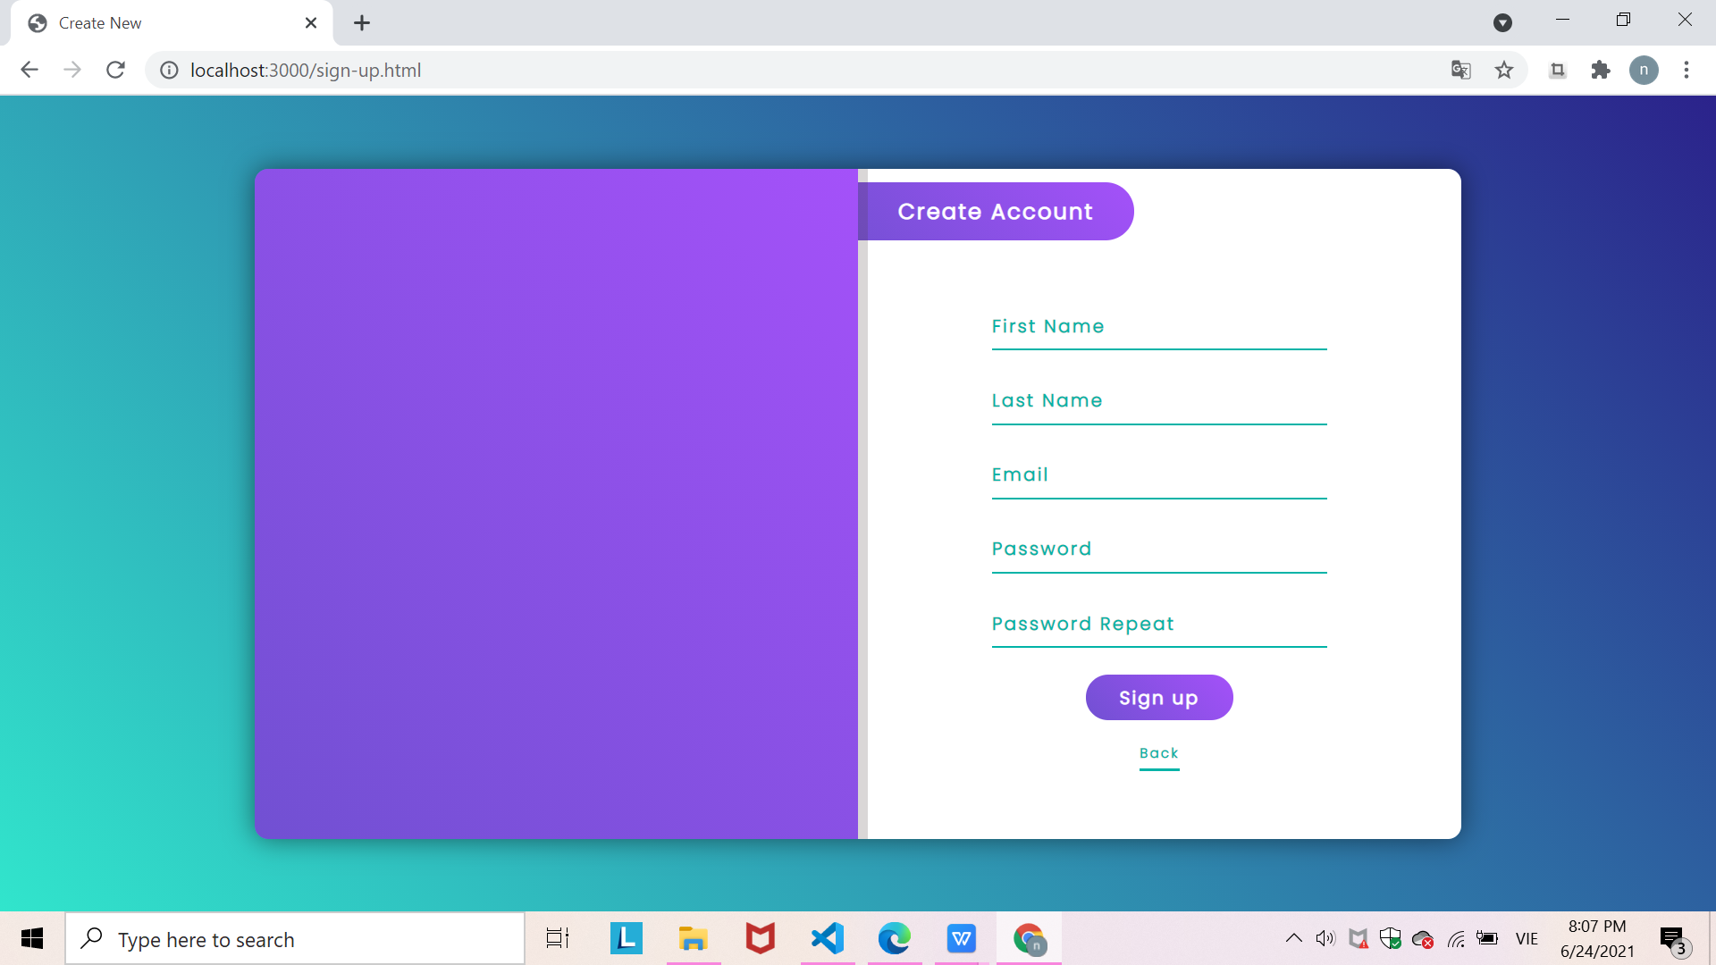
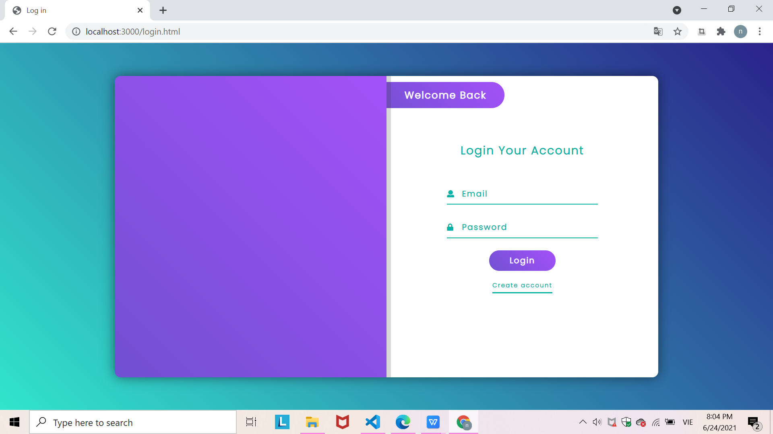
For user:
Login
Create account
Book tour
Search tour (by name, prices, rating stars, services,...)
Send comment

Slide 13
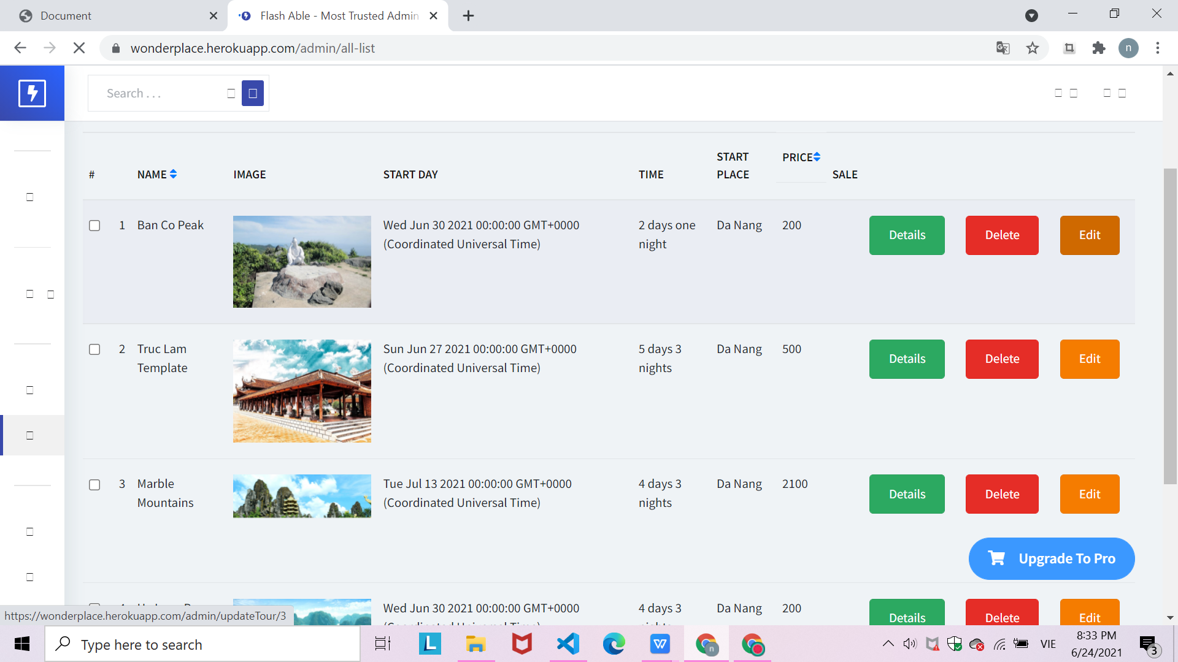
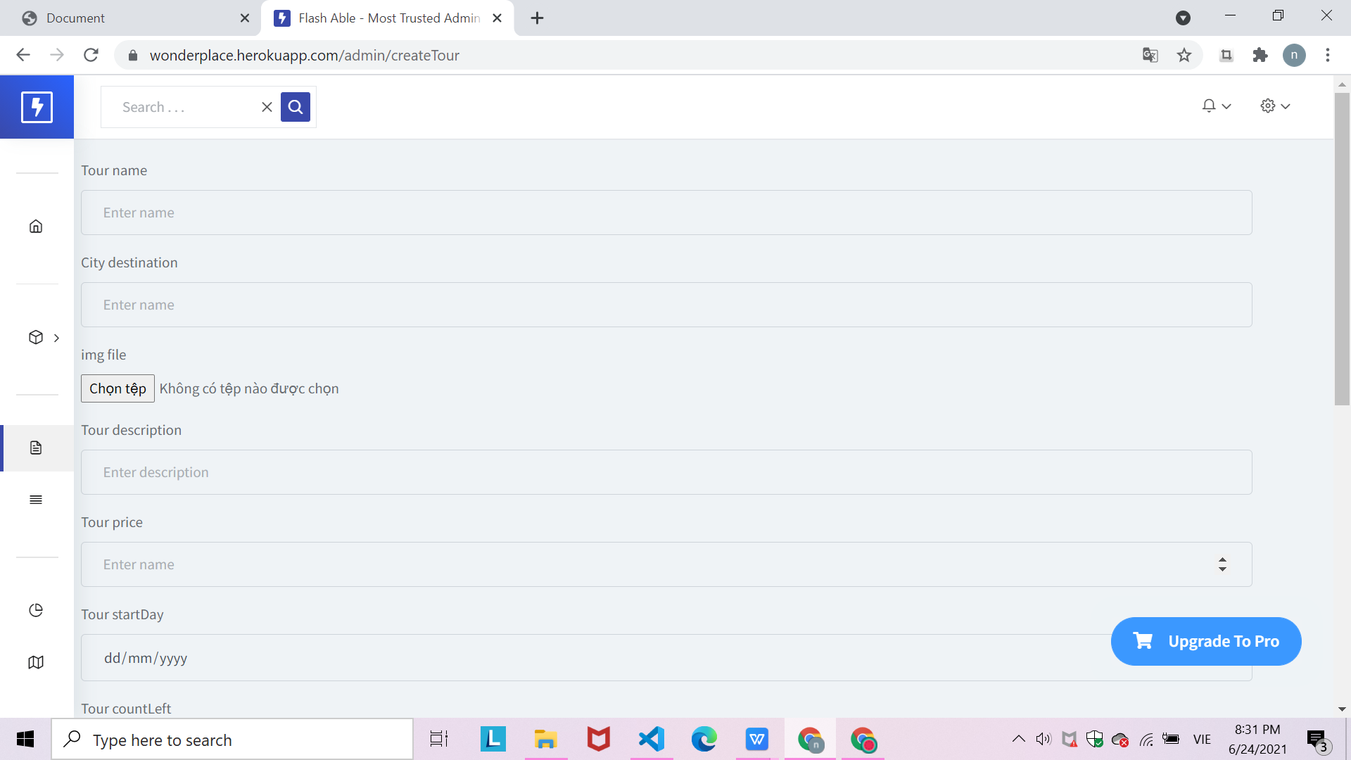
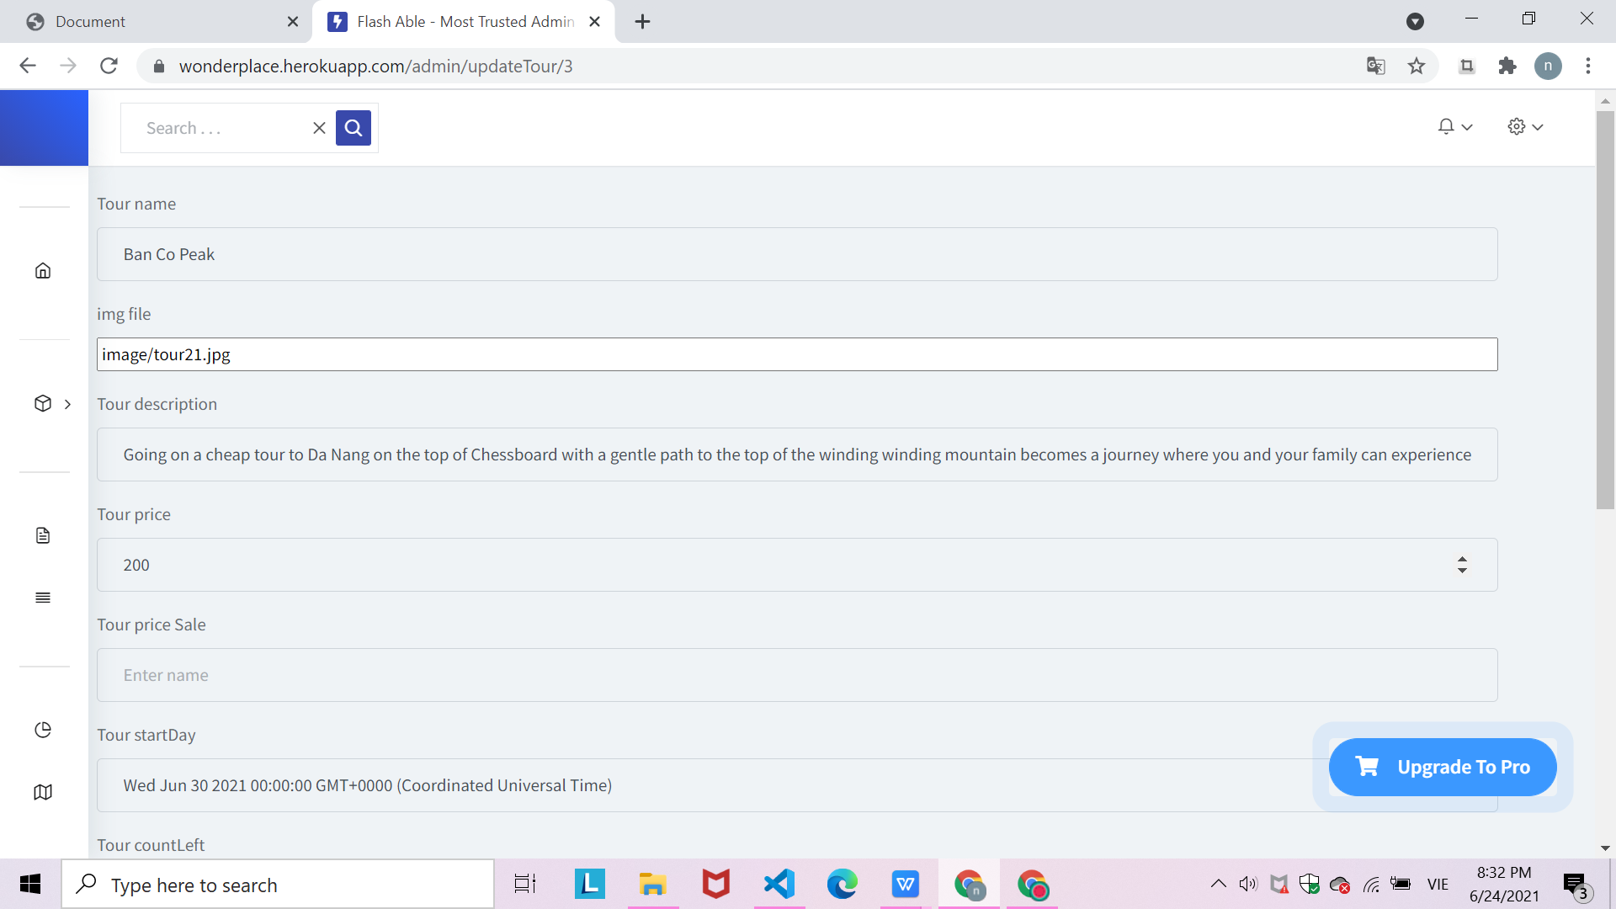
For Admin:
Create new tour
Edit tour
See tour list

Slide 14

THANKS!
Do you have any questions?

